Slide 1
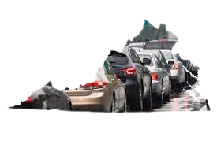
The State of Virginia Car Crash Data Analysis from April 2020 to July 2022
By Selamawit Mekonnen

Slide 2


Introduction
Nashville city cemetery is the oldest continuously operated public cemetery in Nashville.
The city cemetery was listed in the national Register places in 1972 because of its historical and architectural significance
The city cemetery provides free tours on second Saturday of each month. These covers various aspects of the history buried here and the cemetery’s story.

Slide 3
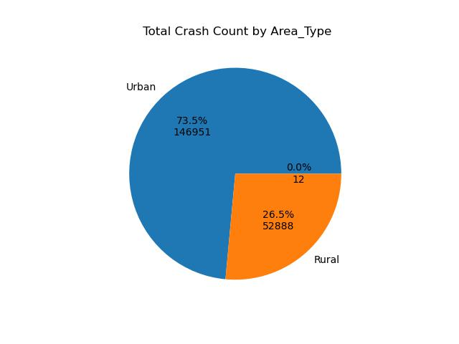
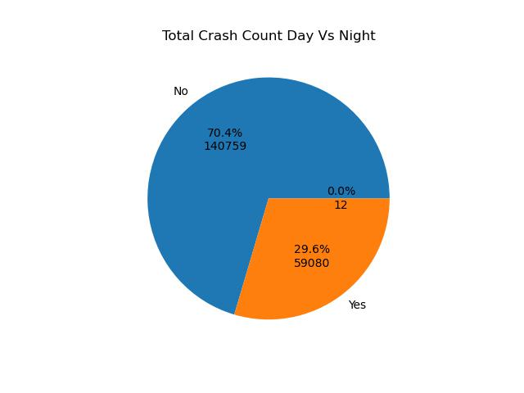
Total Crash count based on Area Type and Day vs Night

Slide 4
Data questions?
What are the primary contributing factors to crashes in Virginia?
What is the distbution of fatality rate across Virginia counties,and which counties exhibt the highest fatalities rate?
What are the external factors to crashes in Virginia, such as alcohol_bike,','distracted','drowsy,drug,, 'hitrun,'lgtruck,','motor,'ped_?
. How has the frequency and severity of crashes varied over the years?

Slide 5
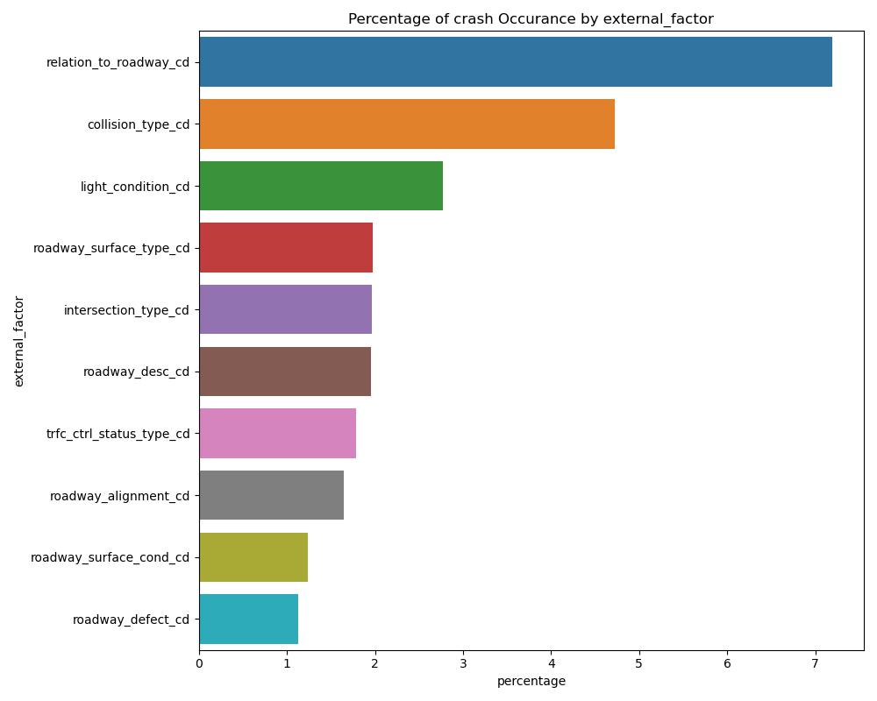
What are the primary contributing factors to crashes in Virginia?
The factor of Relation to Roadway is the primary factor which include aspects such as the crash occurred at an intersection , non intersection , entrance/Ramp ,Roadway-Mainline and its high-risk areas to contribute accidents.and the second factor are collision_type and third are because of light condition.

Slide 6
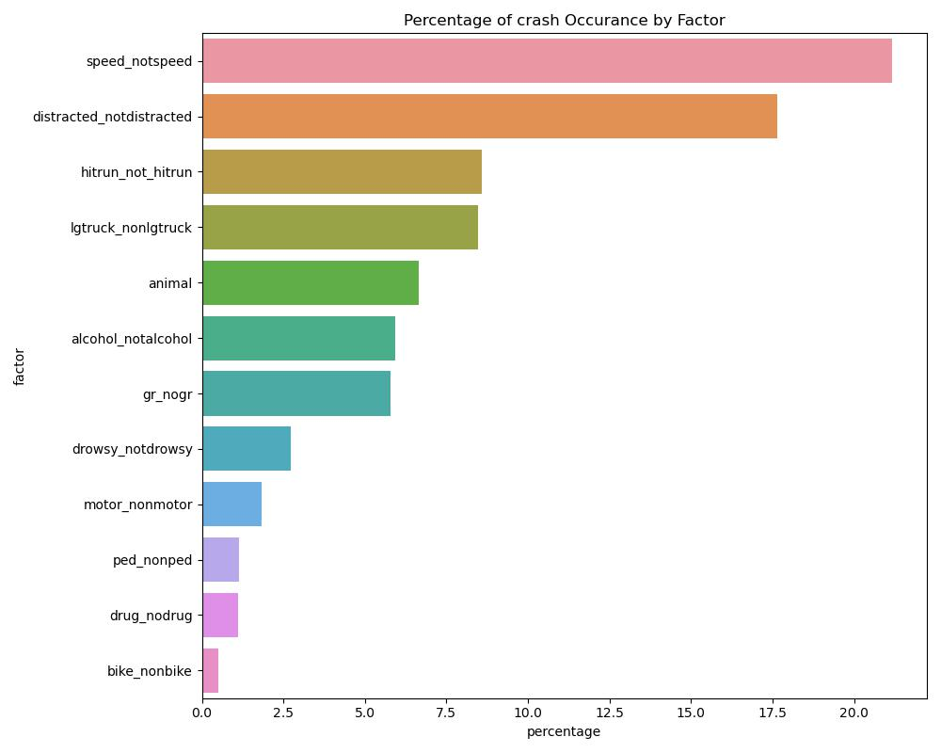
What are the primary contributing factors to crashes in Virginia?
Among these factors the highest percent of crashes is attributed to speeding, followed by distracted driving and hit- and run -inc idents. This suggest that drivers driving traveling at high speeds are are more likely to lose control or have less time to react to road conditions or action of other drivers, leading to a higher incidence of crashes.Distracted driving,which can include texting, using a phone, adjusting the radio ,or othear activities that take the drivers attention away from the road, it also a significant contributor to accidents.

Slide 7
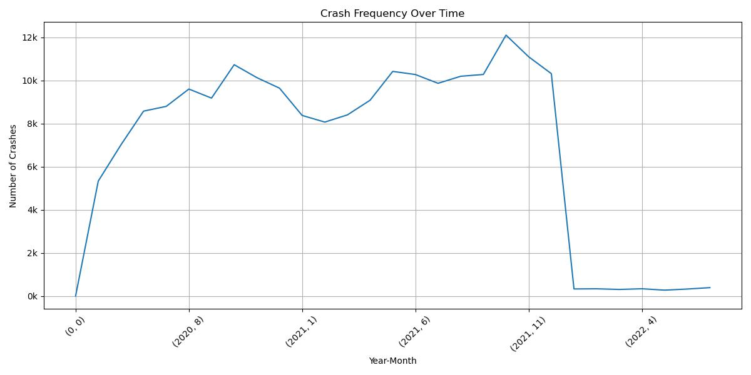
. How has the frequency and severity of crashes varied over the years?
The NSC also says that

Slide 9
What are the external factors to crashes in Virginia, such as alcohol_bike,','distracted','drowsy,drug,, 'hitrun,'lgtruck,','motor,'ped_?tt

Slide 10
. Data questions? What are the primary contributing factors to crashes in Virginia

Slide 11
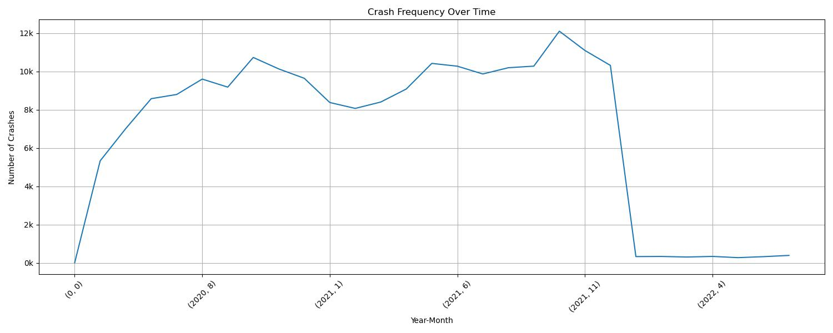
In 1864….

Slide 13
Recomendation
By considering and addressing the factors of relation to Roadway type implement targeted engineering solutions such as signal upgrades,lanemarkings,and advanced intersection design
To enhance safety at intersection.
Introducing traffic calming measures in residential and high crash areas, such as speedbumps, chicanes or narrower lanes.
Implement stricter speed enforcement measures, such as increased police patrols in high risk areas and the use of speed cameras .
.Enforce existing laws against distracted driving more rigorously and consider increase penalty for violation.
Partner with cell phone companies and app developers to create technologies that limit the functionality of devices while a vehicle is in motion.

Slide 14

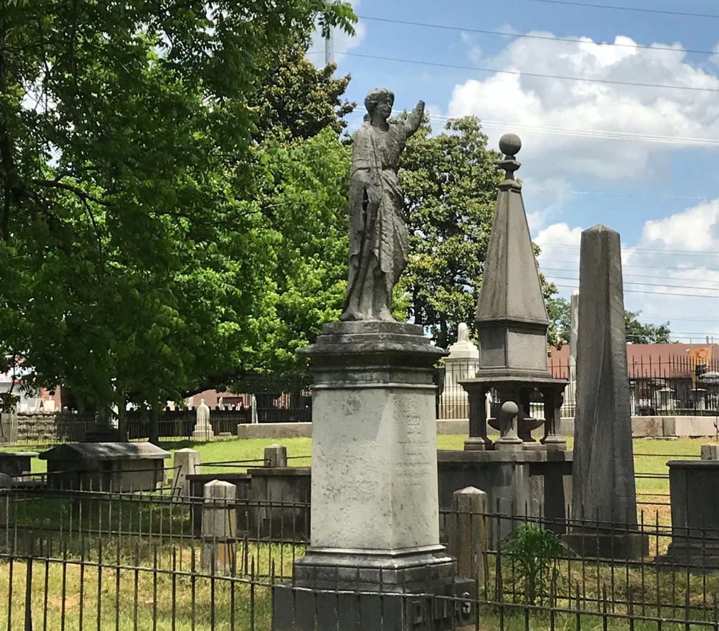
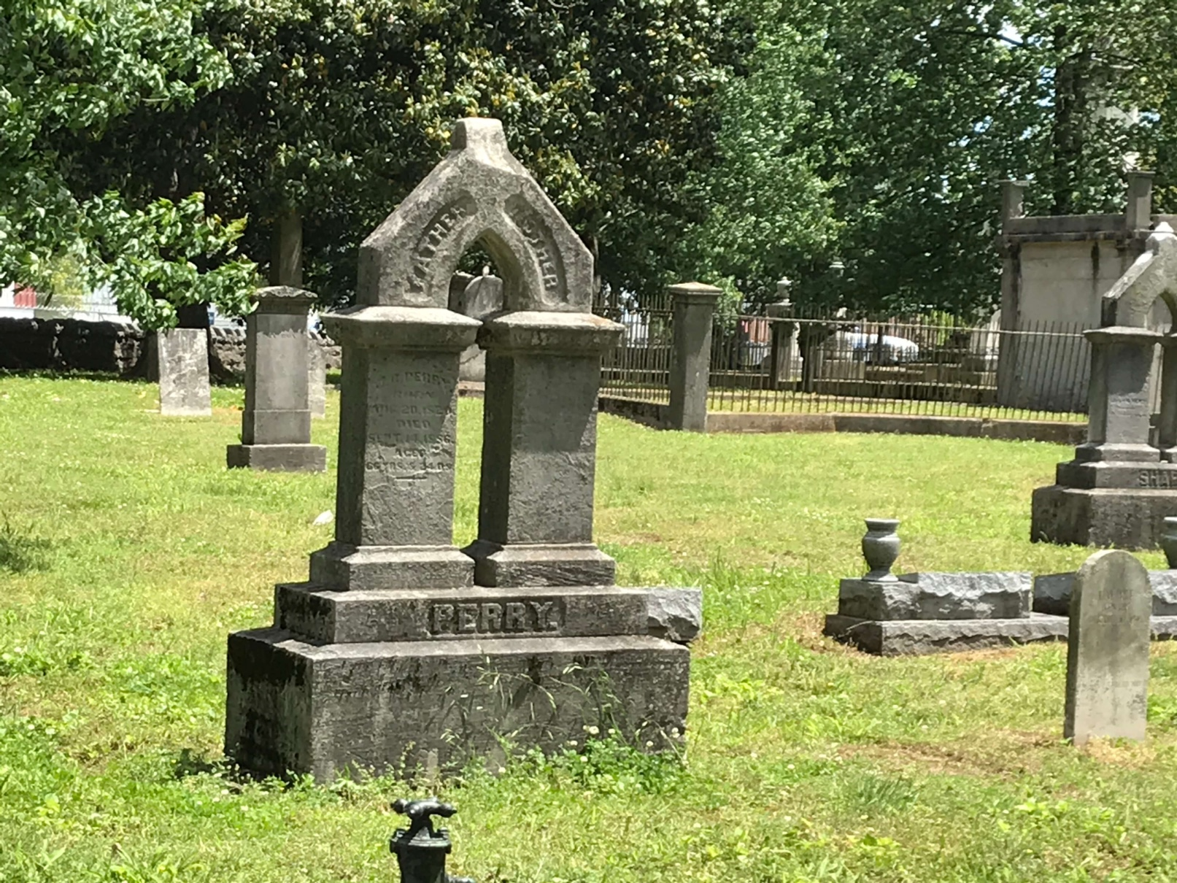


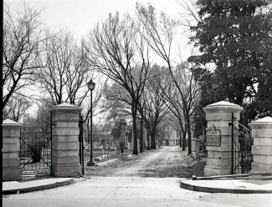
Thank you!
References
https://thenashvillecitycemetery.org/tours
Data Provided By
Historical Commission
Original Nashville City Cemetery Interment Books
Selamawit Mekonnen

